Slide 1
Updates 06/23/2021
Analysis of phylogenetic conservation of the
polyA-HP bulges.
Obtaining polyA-HP sequences is non-trivial.

Slide 2
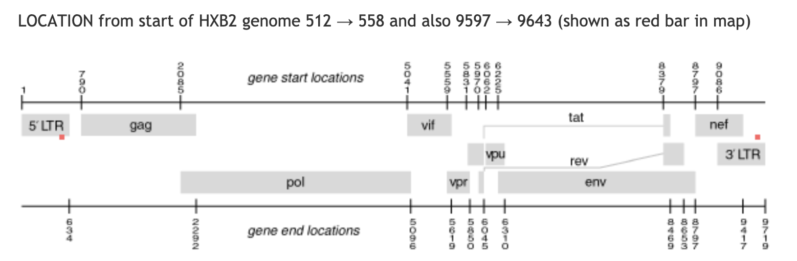
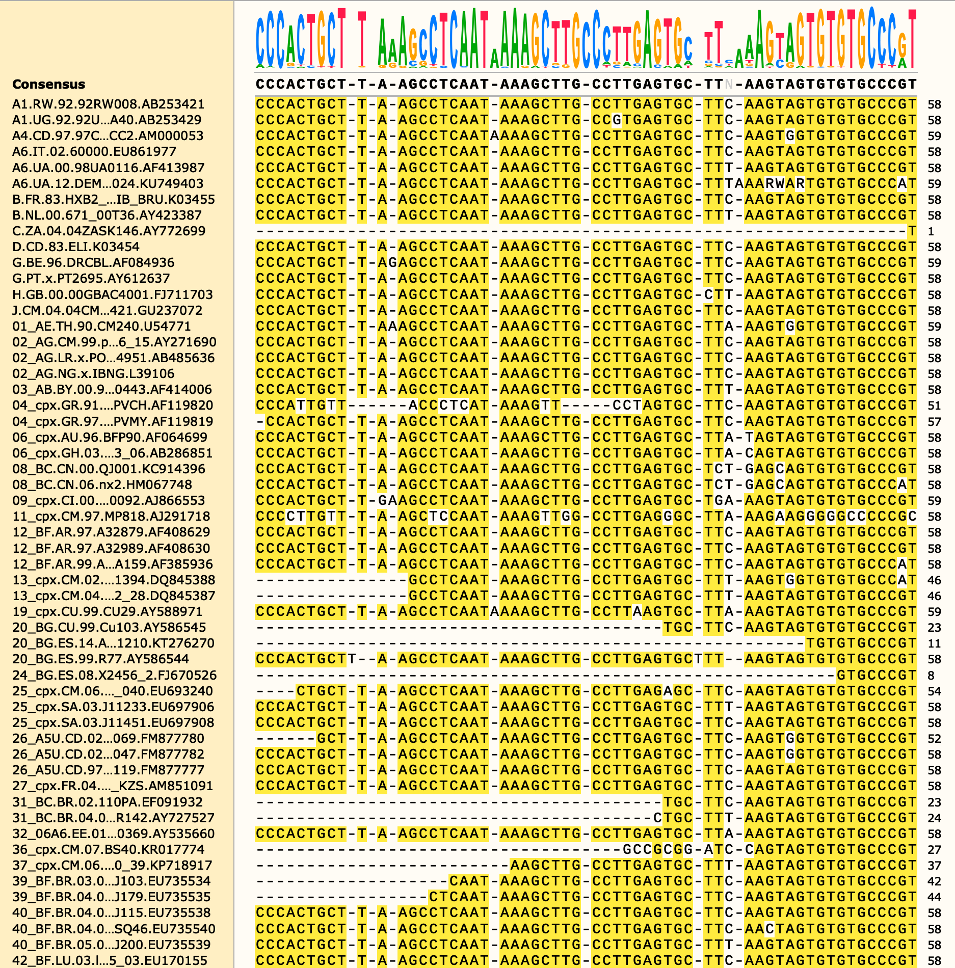
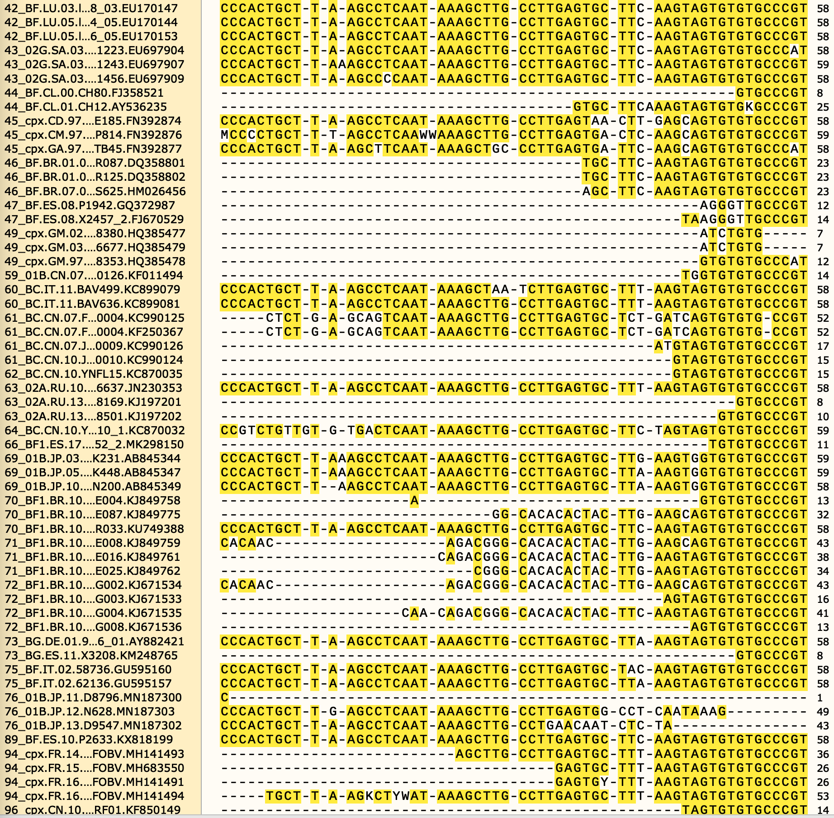
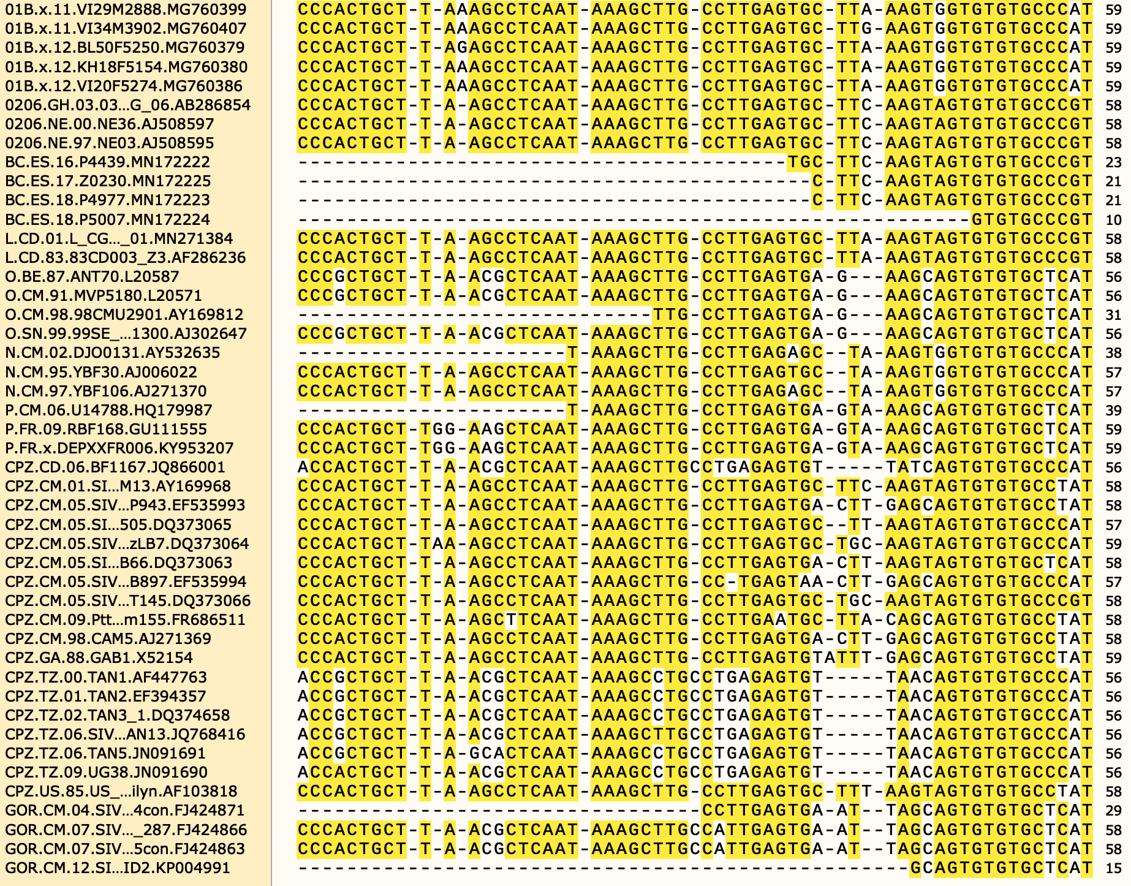
LANL HIV Compendium Curated Alignment of the polyA Hairpin
Coordinates: 510-567

Slide 3
LANL HIV Compendium Curated Alignment of the polyA Hairpin
Coordinates: 510-567
Potential approach: Ignore strains that have little to no coverage.
25% of strains have more than 50% gaps
32% of strains have more than 30% gaps

Slide 4
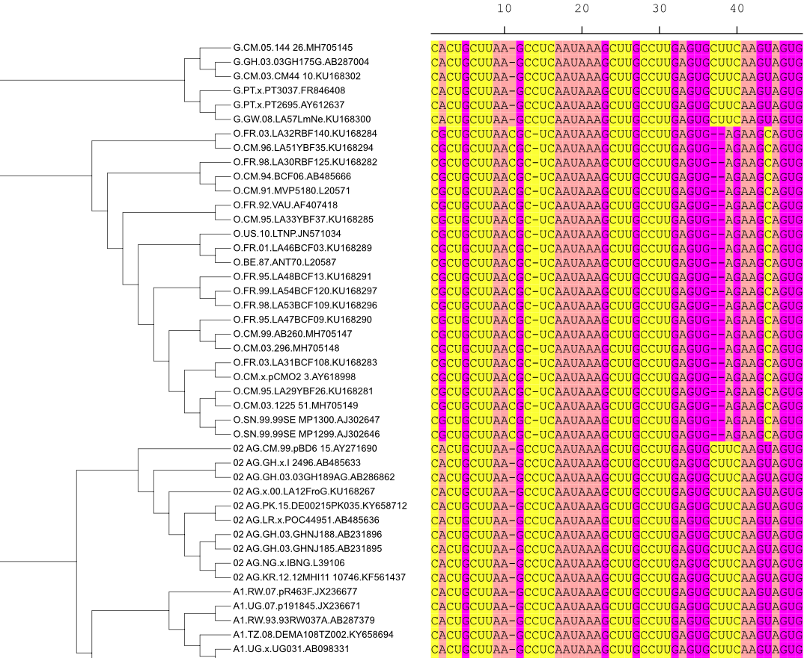
LANL HIV Compendium Curated Alignment of the polyA Hairpin
Coordinates: 510-567

Slide 5
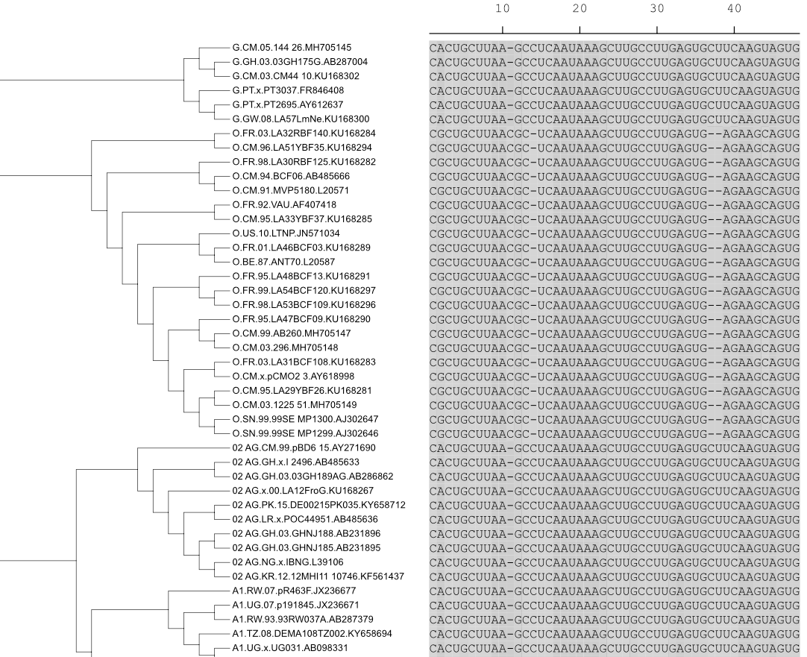
LANL HIV Compendium Curated Alignment of the polyA Hairpin
Coordinates: 510-567
Removing strains with low coverage introduces bias.

Slide 6

Parsing polyA-HP Sequence from 5’-L sequence
Find AAUAAA signal
Pull a segment that is extended ~50nt upstream and downstream from the AAUAAA
5’
3’
Assumption
True polyA-HP is a subsequence of the ~100nt initial segment.

Slide 7

Parsing polyA-HP Sequence from 5’-L sequence
Sample all possible subsequences in search of true polyA-HP sequence
5’
3’
Δ5’ | Δ3’
1 | 0
2 | 0
3 | 0
…
…
0 | 4
0 | 3
0 | 2
0 | 1
Total: 50 x 50 = 2500 subsequences

Slide 8
Parsing polyA-HP Sequence from 5’-L sequence
Restrained by:
Single hairpin
max_unbp_ratio
hwd_limit
Assign the subsequence with the lowest predicted ΔG𐩑 as the true polyA-HP
Secondary structure prediction for each subsequence
Total: 50 x 50 = 2500 subsequences
Filter out sequences not between min_len and max_len

Slide 10
Future Directions
AAUAAA is not aligned in the MSA.
polyA-HP was only found for 107/465 strains.
Notes:
look into doing secondary strccture predictions including TAR
Align AAUAAA first in the MSA

Slide 11


